Slide 1
Translating the evidence
CDS 663
March 9, 2021

Slide 2
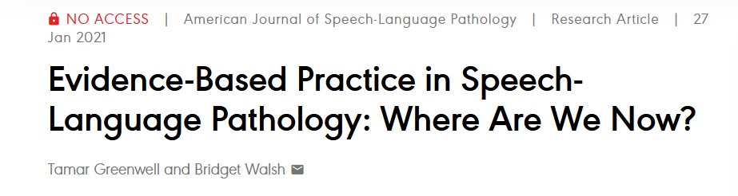
Why talk about this?
“Exposure to EBP in graduate school and during the CF, perception of barriers, and EBP career training significantly predicted the use of EBP in clinical practice.”
Notes:
Three hundred seventeen speech-language pathologists completed an online questionnaire querying their perceptions about EBP, use of EBP in clinical practice, and perceived barriers to incorporating EBP.
Predictors of EBP, Sources of EBP, Perceived barriers, and attitudes toward EBP

Slide 3
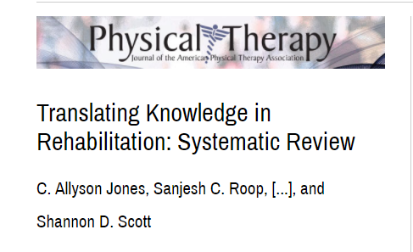
What is knowledge translation?
“an active process that facilitates the introduction of new evidence into practice…includes identifying optimum strategies to close the gap between research and clinical practice”
Passive Active
“showed that educational meetings were commonly used KT strategies specifically directed at translating research into practice and enhancing research uptake in rehabilitation disciplines”
discrepancies were seen between the outcomes reported in the “Method” and “Results” sections.
inconsistencies were seen with the use of multiple tools and approaches to evaluate the primary outcome.

Slide 4
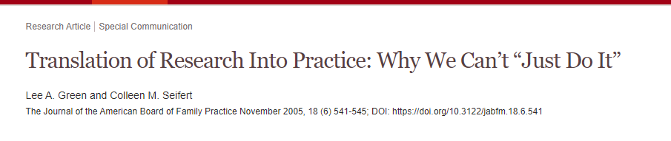
Stages
Awareness
Acceptance
Adoption
Notes:
Awareness: Conducting peer support groups is good for adolescents with TBI
Acceptance: if an adolescent is showing _________ signs, then I should do __________
Adoption: I have

Slide 5
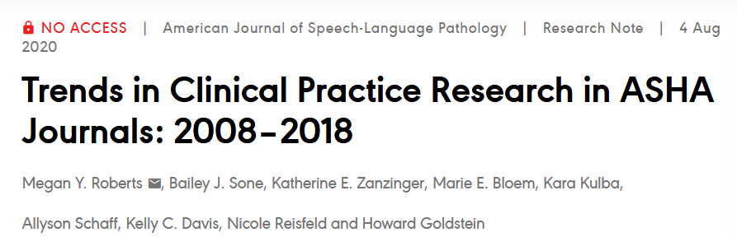
What do we know about the type of research being published in the field of SLP?
Notes:
even for a clinician who is highly motivated to use research to inform clinical decisions and who also has the knowledge and skill to find and evaluate the articles, implementing an evidence-based intervention with only the research article in hand may be difficult. In fact, only 28% of speech-language intervention clinical trials contained a complete description of all intervention elements (Ludemann et al., 2017
A systematic review of barriers to evidence-based medicine noted that a lack of clinically relevant studies is the most frequent barrier to use and implementation of EBP (Sadeghi-Bazargani et al., 2014). Other identified barriers include (a) resources (e.g., lack of infrastructure, lack of time); (b) attitudes and expectations toward EBP (e.g., EBP not valued by supervisors, EBP not viewed as part of clinical duties); and (c) knowledge (e.g., lack of skills to find, understand, and implement research; Harding et al., 2014).
SLPs report using research studies less than any other form of information when making clinical decisions (McCurtin & Clifford, 2015; Zipoli & Kennedy, 2005). Instead, continuing education, personal contacts, websites, and books are the most frequently used sources of information to make clinical decisions (NailChiwetalu & Bernstein Ratner, 2007; Zipoli & Kennedy, 2005). However, when SLPs use research articles to obtain information, ASHA journals are the most frequent journals accessed (Nail-Chiwetalu & Bernstein Ratner, 2007)
the results of this study indicate that clinical practice research comprises the minority (~25%) of the research articles published in ASHA journals, and this trend does not appear to be changing. Given the broad scope of practice in speech-language pathology, this yields a dearth of information in any single general area of study and even less when answering a clinical question about a specific population. Even fewer implementation studies included SLPs as the primary participants, calling into question the real-world feasibility of most research available to practicing clinicians. In fact, only a single study tested an implementation strategy specifically for SLPs (Bainbridge et al., 2015).

Slide 6
Translating evidence: a good starting point?
Systematic reviews
Clinical practice guidelines
Provide overview of clinical implications/ trends
Clinical practice recommendations

Slide 7
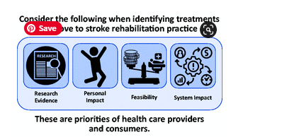
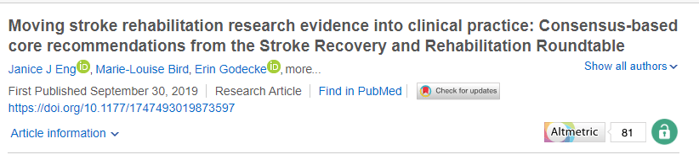

Slide 8
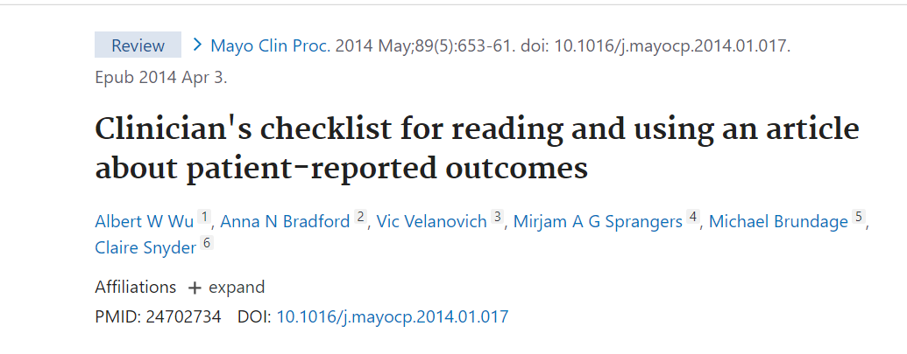
Evidence-based checklists

Slide 9

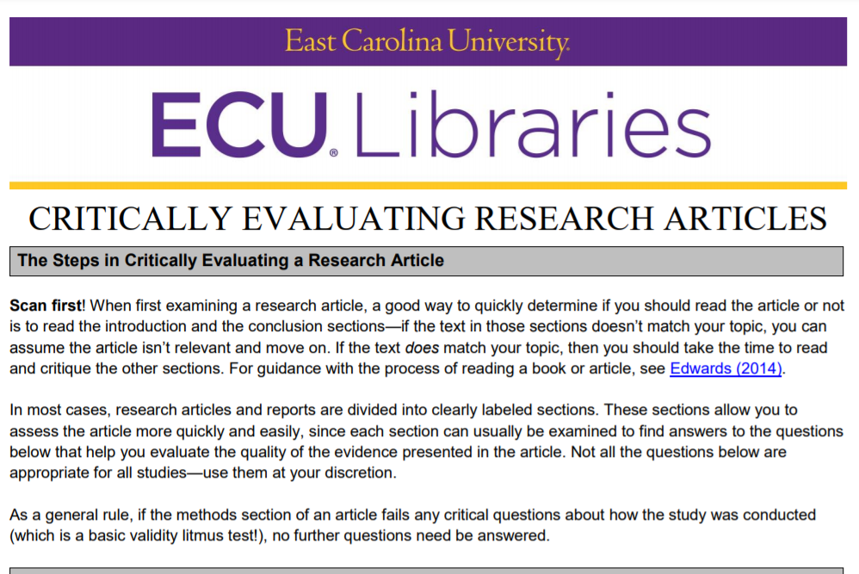
Evidence-based checklists
Notes:
How to read a research paper: https://www.ncbi.nlm.nih.gov/pmc/articles/PMC2127173/pdf/9253275.pdf
Statistics for the non-statistician: https://www.ncbi.nlm.nih.gov/pmc/articles/PMC2127256/pdf/9270463.pdf

Slide 10
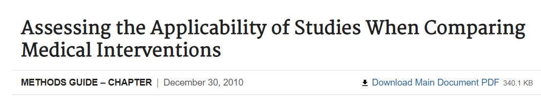
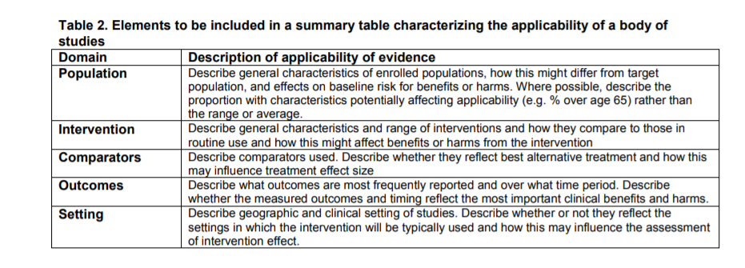
EVIDENCE-BASED GUIDELINES ON JUDGING RESEARCH APPLICABILITY

Slide 11
What should clinicians know about reading research?
Clinical implications section
Framework for analyzing clinical utility
Assessment
Population?
Access to tool for free?
Ease of administration
Ease of scoring
Intervention
Population?
Methods replicable?
Clinically feasible dosage/frequency?
Adaptable ingredients?
Service delivery / Interprofessional practice

Slide 12
Million-dollar question
Awareness – is this info I need to simply be aware of?
Acceptability – if I see a client with ________ with a blank presentation, can I use _________
Adoptability – If I see a client tomorrow, should I use this in my session?

Slide 13
Putting into practice
Let’s evaluate the clinical utility of some papers!

Slide 14
But I’m going to be a busy clinician!
Online educational platforms
ANCDS, STEP, Medbridge, ASHA Learning Pass
Blogs
Paid: TISLP
Unpaid: swallowstudy.com, eatspeakthink.com, brainline.org,
Podcasts
Down the Hatch, ANCDS podcast, AphasiaAccess

Slide 15
Summary
Before reading an article, identify what you already know about the topic (textbook, clinical guidelines, systematic reviews)
Ensure that you have a checklist that helps you extract pertinent info
Compare what the study claims to what you already know
Translate the knowledge:
AWARE? ACCEPT? ADOPT?

